Slide 1
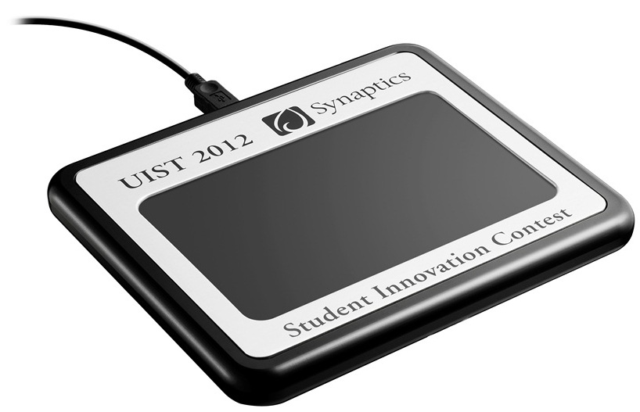
UIST Student Innovation Contest

Slide 2
The Hardware

Slide 3
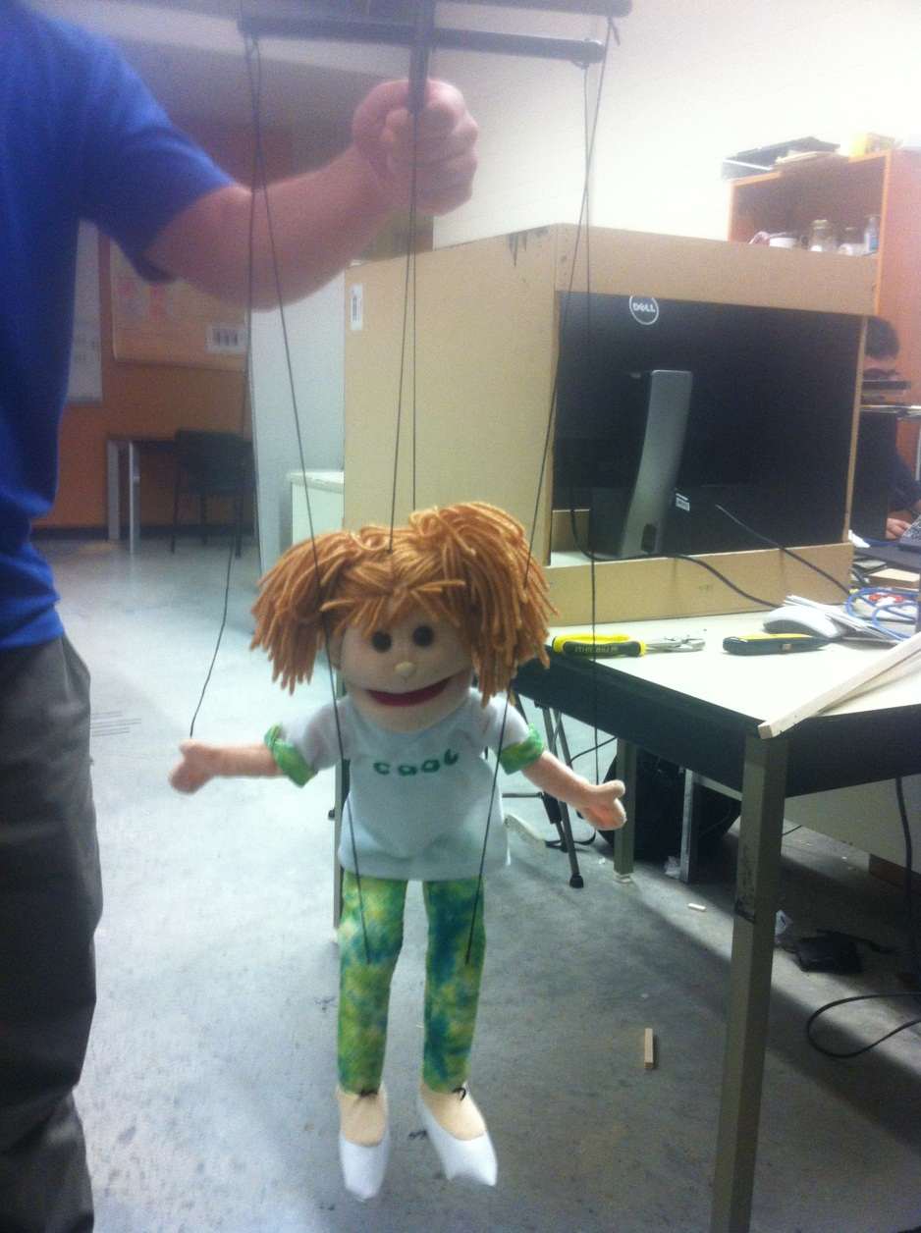
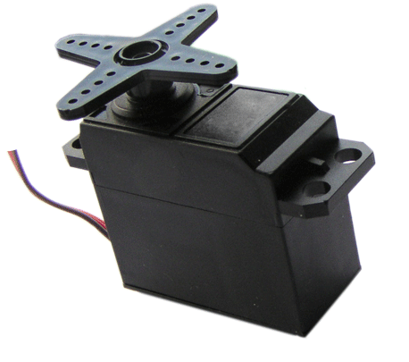
The Idea

Slide 4
The Software
Not sure what to put here…

Slide 5
Pulling it all together
See Roiy’s computer

